Slide 1
Block-chain for Storage

Slide 2
Block-chain for file systems
Block chains can act as a mechanism to implement files tracing and also a method for file system backup and recovery.
In critical file system every addition and deletion of files is important and it equally important to audit these changes.
Block Chain serves as a method that can hold traces of every transaction in the file system that occurs.

Slide 3
Architecture for block-chain
In systems such as loan agreement storage or any confidential or business documents are stored, a constant threat is modification or even deletion for personal or malicious interests.
To serve security and tracing requirement, Distributed implementation of block chain is considered.
Block chain created for this system uses redundant information storage( similar block chains in multiple distributed systems).

Slide 4
Proposed architecture for file-systems.

Slide 5
The architectural Phases
The architecture comprises of the following phases
Initial extraction of directory structure.
Creation of Initial block (Root for Block chain).
Auto Creation of new block for every transactional updates.
Mechanism to create distributed block chain with redundancy for security.
Traceability mechanism for block chain.

Slide 6
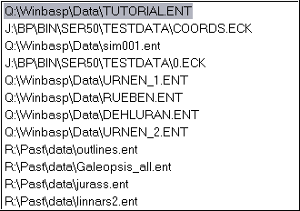
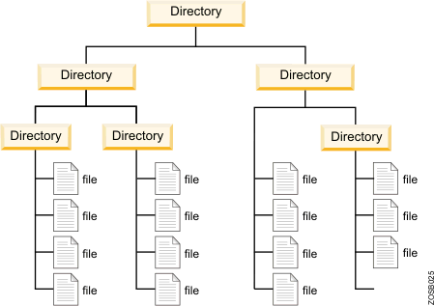

Initial extraction
Data structure creation
Parse
File System
Fully Qualified File Path Names
The database entry with relation having
File paths
Possibly the author(of last update)
File size)
Each Database entry can be a transaction of contain hash for the directory structure.
We can include links to file backups which are file per-modification.
This is a generic parser what runs every tiem a block need to be created.
Any suggestion for security.

Slide 7
Creation of Block root(block structure)
From the Initial extraction create a root block which contains the following
Timestamp for transaction(block creation)
User Private and public keys pertaining to the user initiating the change or block creation
Hash values to the change transaction to the directory structured stored in DB
A Block checksum to authenticate the blocks
Block headers contain links to previous and next block( initialised dynamical at a block creation in a block chain).
Reference for the structure : https://www.oreilly.com/ideas/understanding-the-blockchain

Slide 8
File compare and Directory compare mechanism
When the directory structure is changed by an authorised user which includes
File movement
Deletion of file
Or Addition of new file
A block need to be reacted using the transaction details
Is the file has changed (content)
Use of SVM File compare mechanism (integration) to record file updates and properties.
At both points a backup of file is reacted and stored in the transaction. (mechanism to backup recovery need to be figured out)

Slide 9
Block-chain trace
I need to do more reading to update this slides

